Slide 1
Magnetism
High School Science
M.Clayton
Group Project

Slide 2
High School Science
Magnetism
Group Project
WARM-UP

Slide 3
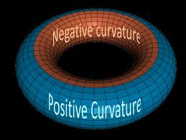
High School Science
Magnetism
Group Project
Look at these pictures and identify what they have in common?

Slide 4
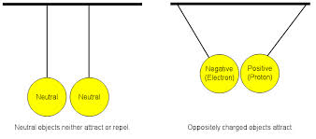
High School Science
Magnetism
Group Project
OPPOSITES ATTRACT!

Slide 5
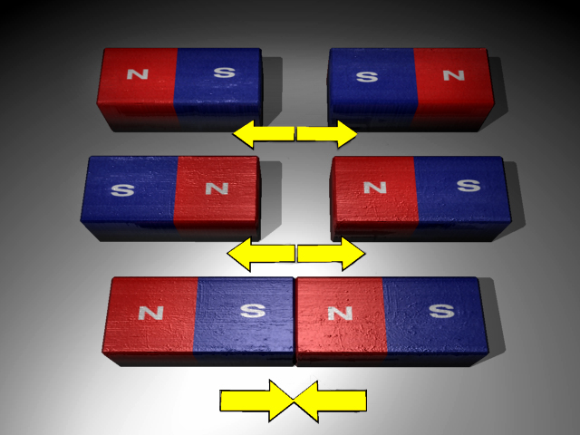
High School Science
Magnetism
Group Project
OPPOSITES ATTRACT!

Slide 6
High School Science
Magnetism
Group Project
Georgia Performance Standards (GPS):
SPS10. Students will investigate the properties of electricity and magnetism.
SCSh4.c Use technology to develop, test, and revise experimental or mathematical models.
SCSh6.d Participate in group discussions of scientific investigation and current scientific issues.

Slide 7
High School Science
Magnetism
Group Project
ELACCGPS:
ELACC9-10WHST6. Use technology, including the Internet, to produce, publish, and update individual or shared writing products, taking advantage of technology’s capacity to link to other information and to display information flexibly and dynamically.

Slide 8
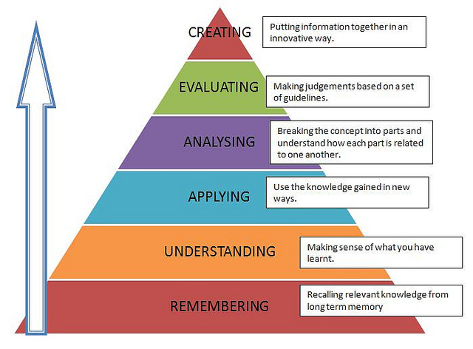
High School Science
Magnetism
Group Project
Objectives
Students will:
- Describe the effects of magnetic forces and magnetic fields and explain how magnetic poles determine the direction of magnetic force.
- Investigate applications of magnetism and/or its relationship to the movement of electrical charge.

Slide 9
High School Science
Magnetism
Group Project
Objectives
- Summarize how electrical energy is produced, transmitted, and converted for use in the home.
- Collect and arrange materials related to the topic, define terms electromagnets, simple motors, and permanent magnets, list approaches and opinions about the topic, and illustrate them with various multimedia (articles, books, video, photos, etc.).

Slide 10
High School Science
Magnetism
Group Project
Objectives
- Critique various opinions about producing and usage of electrical energy, develop logical arguments pro- or con- , and draw conclusions answering the EQ questions.
- Analyze collected material, critique and defend opinions, propose solutions to the identified problems.

Slide 11
High School Science
Magnetism
Group Project
Objectives
- Collaborate on each step of the project.
- Use technologies for group collaboration, collection and analysis of information, and to publish and update the product of the research.

Slide 12
High School Science
Magnetism
Group Project
ESSENTIAL QUESTIONS:
How do magnets interact with one another?
Why are some materials magnetic while others are not?
How can an electric charge create a magnetic field?
What are some sources of electrical energy in the United States?

Slide 13
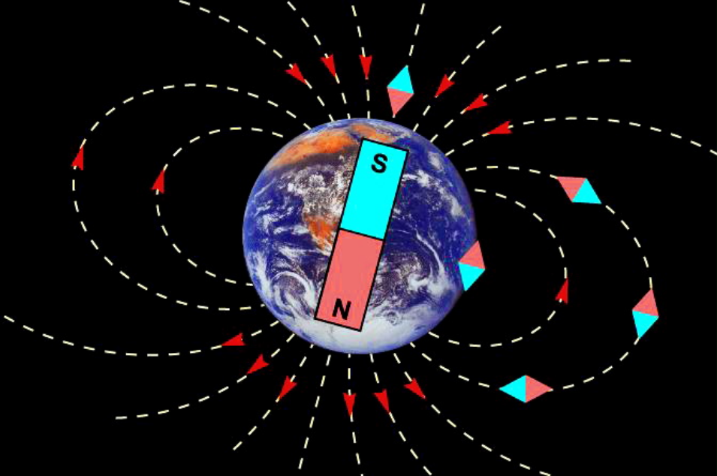
High School Science
Magnetism
Group Project
Part 1. Magnets and Magnetic Fields.

Slide 14
High School Science
Magnetism
Group Project
NO CONTENT FOUND!

Slide 15
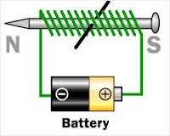
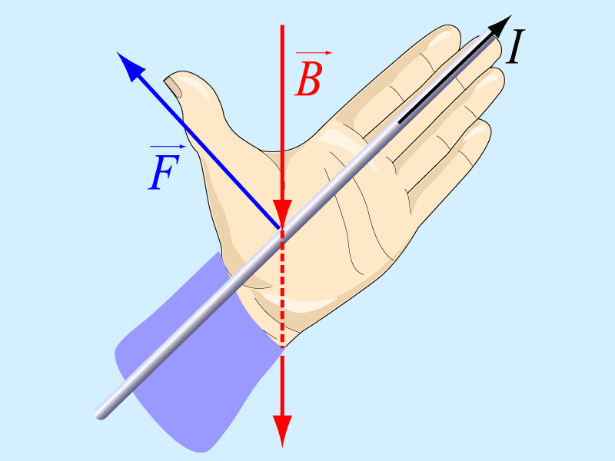
High School Science
Magnetism
Group Project
Part 2. Electromagnetism.

Slide 16
High School Science
Magnetism
Group Project
NO CONTENT FOUND!

Slide 17
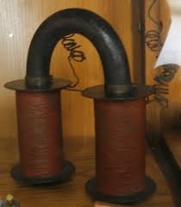
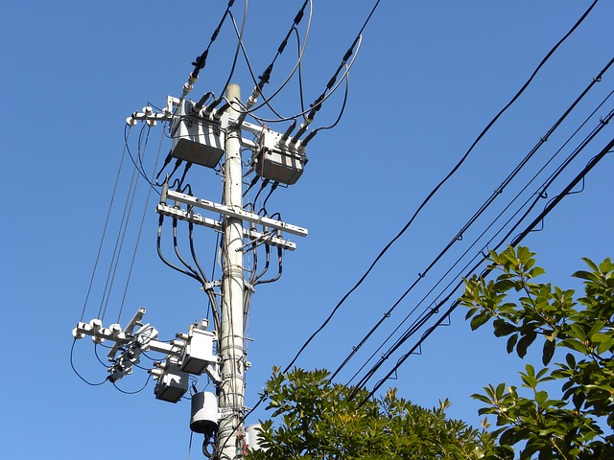
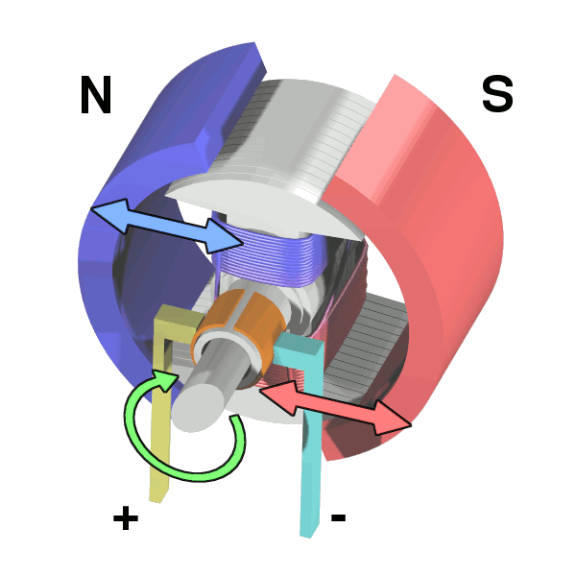
High School Science
Magnetism
Group Project
Part 3. Electrical Energy Generation and Transmission.

Slide 18
High School Science
Magnetism
Group Project
NO CONTENT FOUND!

Slide 19
High School Science
Magnetism
Group Project
GROUP PROJECT

Slide 20
High School Science
Magnetism
Group Project
PROJECT DESCRIPTION
Students will work in three groups creating 3 different web pages for their teacher’s web site. Students will use various resources of their choice and complete different assignments, according to their roles in the group.

Slide 21
High School Science
Magnetism
Group Project
Creating a Web Page for the Teacher’s Web Site
MAGNETISM.
Group 1. Magnets and Magnetic Fields.
Group 2. Electromagnetism.
Group 3. Electrical Energy Generation and Transmission.

Slide 22
High School Science
Magnetism
Group Project
SIGN- UP FOR YOUR GROUP!

Slide 23
High School Science
Magnetism
Group Project
Group Roles
This project requires playing multiple roles from each participant: Leader, Designer, Technical Specialist, Scientist, and Writing Editor. You will have to write content, find images and videos, create assessments, and recommend the lab work, activities, games, etc.

Slide 24
High School Science
Magnetism
Group Project
SIGN- UP FOR YOUR ROLES!

Slide 25
High School Science
Magnetism
Group Project
Links
You will find detailed Project Directions and Recommended Resources following this link.
You can find Project Rubric here.
Project Self- Assessment will be completed at the end of work.

Slide 26
High School Science
Magnetism
Group Project
TESTING TIME!

Slide 27
High School Science
Magnetism
Group Project
Formative Quiz:
How do magnets interact with one another?
Why are some materials magnetic while others are not?
How can an electric charge create a magnetic field?
What are some sources of electrical energy in the United States?

Slide 28
High School Science
Magnetism
Group Project
Summative Assessment:
Unit Test: Socrative.
Follow this link to take the unit test.
Our classroom code is ClaytonRHS.

Slide 29
High School Science
Magnetism
Group Project
More materials for this topic and test preparation you can find on the following sites:
Georgia Virtual Learning
Study Island
USA Test Prep

Slide 30
Ms. Clayton’s Website
Thank you for participation in this project! You can find your web pages on my teacher’s web site.

Slide 31
Resources:
* Wysession, M., Frank, D., & Yancopoulos, S. (2009). Physical Science: Concepts in action. Pearson Prentice Hall, Boston, MA.
* Georgia Virtual School (Digital Textbook) http://cms.gavirtualschool.org
* Commons. Wikimédia http://commons.wikimedia.org/wiki/Main_Page
* Facebook www.facebook.com
* Nearpod Web Site www.nearpod.com
* Socrative Web Site www.socrative.com
* Google Apps: Drive, Draw, Docs, Sites, Slides
* Google Search
* MS Office
* YouTube

Slide 32
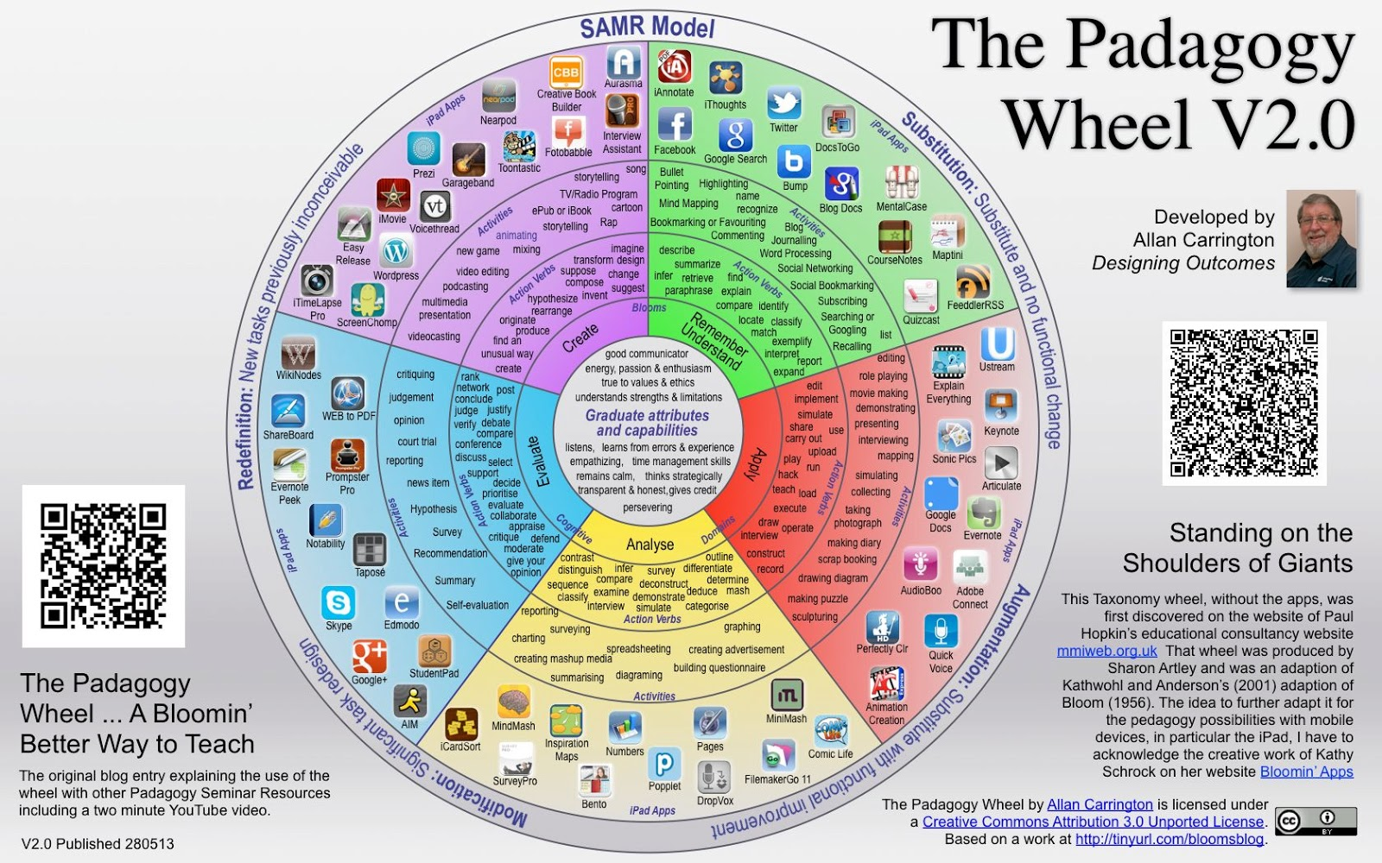
Digital Resources for Teaching & Learning

Slide 33
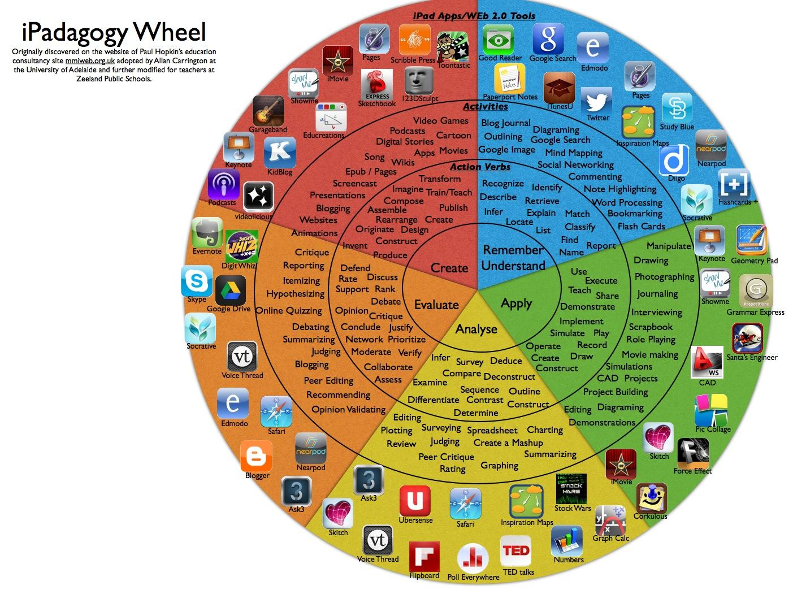
Digital Resources for Teaching & Learning

Slide 34
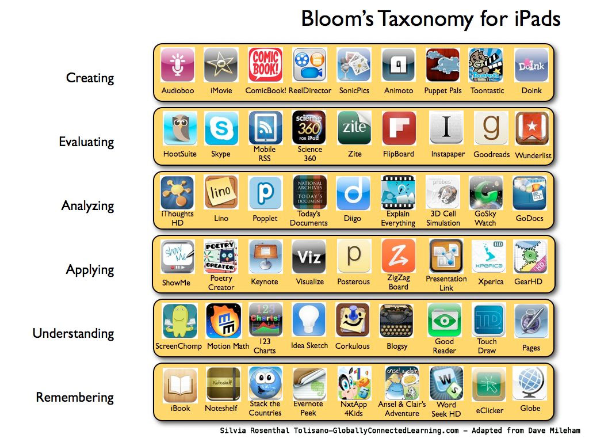
Digital Resources for Teaching & Learning

